Slide 1
Clinical Risk Factor Analysis for 30-Day Diabetic Readmission
Presenter: Andrew Stringer

Slide 2
About Me
Bachelor of Science – Information Technology Management from WGU
Job history includes customer service, management, IT support, and workforce administration
Skills include Python, SQL, and statistical analysis
Have a family history of diabetes

Slide 3
Problem and Hypothesis
Problem
Hypothesis
Patient readmissions within 30 days are costly for hospitals
The safety of the patient is also at risk due to risk of illness, and mistreatment
Clinical markers, such as administering an HbA1c test and adjusting medications, are significantly associated with a reduction in the probability of 30-day readmissions

Slide 4
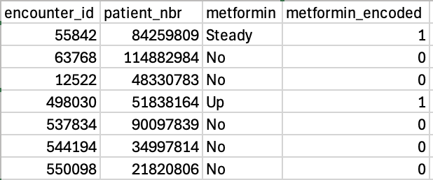
Data Cleaning Summary
Removed 21 of 50 variables that were not relevant to the analysis
Convert medication status into numeric variables for analysis
Created an indicator for whether an HbA1c test was performed
Created an indicator for 30-day readmission
Created an indicator for whether a patient’s medication regimen changed
Removal
Conversion
Creation
Cleaned Data

Slide 5
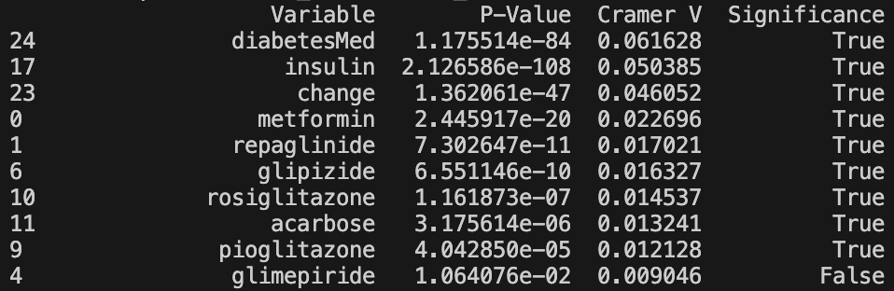
Chi-Square Testing Summary
Conducted a statistical test to examine the relationship between medications and hospital readmission
Organized data into comparison tables for each medication
Adjusted significance thresholds to account for the number of medications
Readmission
> 30 Days
< 30 Days
Medications
Repaglinide
Metformin
Insulin

Slide 6
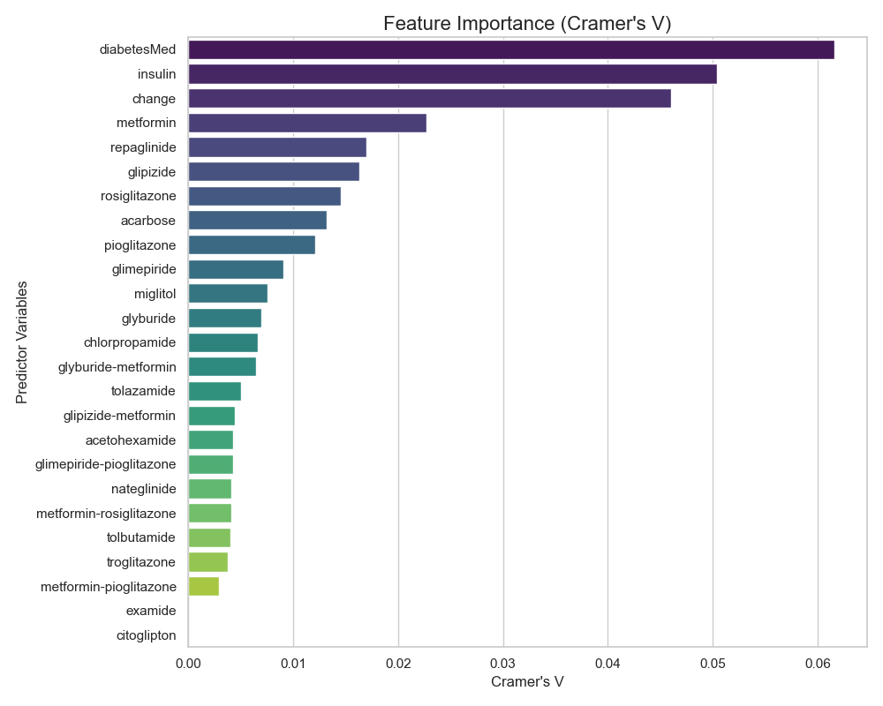
Cramer’s V Summary
Used results from the chi-square test to measure the strength of relationships
Calculated an effect size for medications linked to readmission
Determined how strong the relationships were, not just whether they were statistically significant

Slide 7
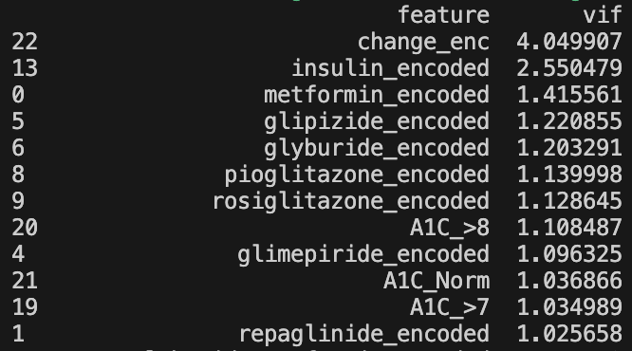
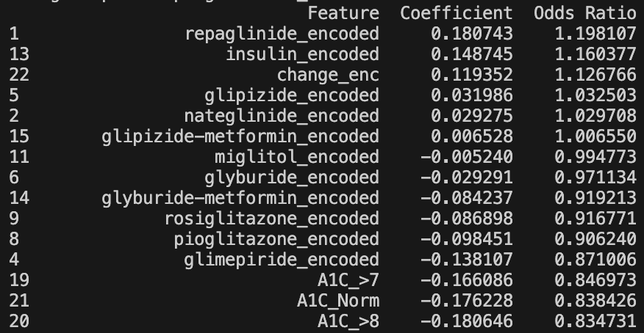
Logistic Regression Summary
Split the data into training and testing sets to evaluate model performance
Checked for overlapping variables to ensure reliable results
Estimated how different medications affect the probability of readmission
Evaluated whether receiving an HbA1c test was associated with lower readmission probability

Slide 8
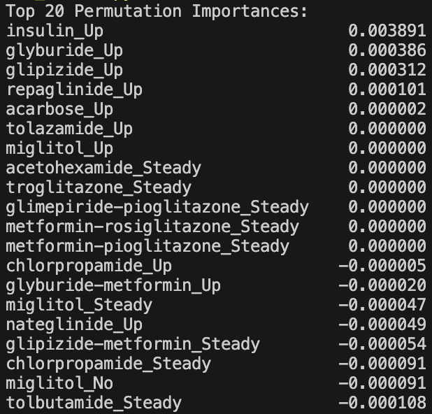
Random Forest Summary
Used patient and treatment variables as predictors and readmission as the outcome
Split the data into training and test sets to evaluate performance
Ranked the most important predictors using feature importance analysis
Visualized how key variables influence readmission probability
Used model explanation techniques to understand how individual variables contribute to predictions

Slide 9
Summary of Findings
Diabetes medications and having an HbA1c test administered show statistically detectable but practically weak relationships with 30-day readmission rates
Repaglinide, Insulin, and a general change in medication increases the probability of readmission under 30 days by 13-20%
Metformin-Rosiglitazone, Chlorpropamide, Acarbose, and Metformin lower the probability of readmission under 30 days by 19-36%
Having an HbA1c test administered lowers the probability of readmission under 30 days by 15-17%

Slide 10
Limitations of the Analysis
P-values are not very informative due to the dataset size, over 100,000 rows
Cramer’s V cannot provide information about the direction of a relationship, requiring other analytical methods
Logistic regression assumes a linear relationship
Random forest models can be memory intensive, especially on large datasets

Slide 11
Proposed Actions
Use Metformin-Rosiglitazone, Chlorpropamide, Acarbose, and Metformin before other diabetes medications when possible
Always administer an HbA1c test
Patients who are prescribed Repaglinide or Insulin, or who have had recent medication changes, should undergo more comprehensive health screenings to identify diabetes-related conditions that can be addressed during their stay

Slide 12
Benefits of Analysis
One preventable diabetic ketoacidosis admission costs the same as 27 years of insulin therapy (AlShamsi et al.) For 1,000 readmissions per year, reducing readmission by 17% could save $425K – $1.06M annually due to the cost of insulin therapy
Hospitals with higher readmissions compared to national averages can be docked a 1-3% penalty on reimbursements from Centers for Medicare and Medicaid Services’ (CMS) (“Hospitals with the Highest Readmission Penalties”). For a hospital with $200M in annual Medicare revenue, a 3% penalty is a $6M loss
Adult patients with diabetes represent 10-25% of all 30-day unplanned hospital readmissions (Gek et al.) For 1,000 readmissions per year, reducing readmission by 17% could save $260K - $660K annually

Slide 13
Sources
AlShamsi, Fayez, et al. “Identifying the Healthcare Burden of Diabetic Ketoacidosis: Economic Analysis and Mitigation Strategies for Adult Patients in the United Arab Emirates.” Diabetes Therapy, 1 Nov. 2025, link.springer.com/article/10.1007/s13300-025-01812-w#Abs1, https://doi.org/10.1007/s13300-025-01812-w. Accessed 14 Mar. 2026.
Gek, Jade, et al. “Predicting and Validating 30-Day Hospital Readmission in Adults with Diabetes Whose Index Admission Is Diabetes-Related.” The Journal of Clinical Endocrinology & Metabolism, vol. 107, no. 10, 23 June 2022, pp. 2865–2873, academic.oup.com/jcem/article/107/10/2865/6615329?login=false, https://doi.org/10.1210/clinem/dgac380. Accessed 14 Mar. 2026.
“Hospitals with the Highest Readmission Penalties.” Definitive Healthcare, 26 Nov. 2025, www.definitivehc.com/resources/healthcare-insights/hospital-readmission-rate-penalties. Accessed 14 Mar. 2026.
Soh JGS, Wong WP, Mukhopadhyay A, Quek SC, Tai BC. Predictors of 30-day unplanned hospital readmission among adult patients with diabetes mellitus: a systematic review with meta-analysis. BMJ Open Diabetes Research & Care. 2020;8:e001227. https://doi.org/10.1136/bmjdrc-2020-001227
Yun, Jaehyeon, et al. “Predicting Hospital Readmission in Medicaid Patients with Diabetes Using Administrative and Claims Data.” The American Journal of Managed Care, vol. 29, no. 8, 22 Aug. 2023, www.ajmc.com/view/predicting-hospital-readmission-in-medicaid-patients-with-diabetes-using-administrative-and-claims-data. Accessed 14 Mar. 2026.

